Slide 1
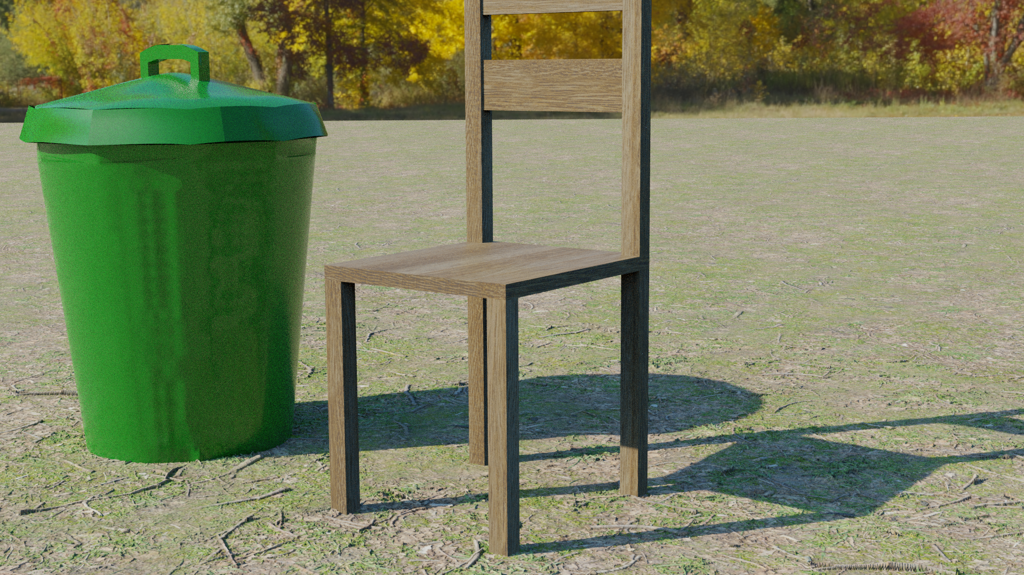
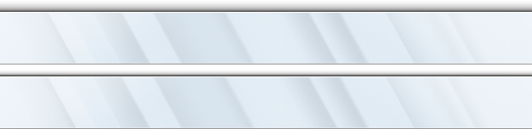




AERO OFF
Windows
Hello Aero
Just theme
Great
Beautiful
Cool
Enjoy it！

Slide 2
AERO LOW
Windows
Hello Aero
Just theme
Great
Beautiful
Cool
Enjoy it！

Slide 3

AERO HIGH
Windows
Hello Aero
Just theme
Great
Beautiful
Cool
Enjoy it！

